Slide 1
Pima Diabetes Predictor
- Chinmayi Lekurwale

Slide 2
Problem Statement
Predict the onset of diabetes based on diagnostic measures
Data Description:
This dataset is originally from the National Institute of Diabetes and Digestive and Kidney Diseases.
The objective of the dataset is to diagnostically predict whether or not a patient has diabetes, based on certain diagnostic measurements included in the dataset.
Several constraints were placed on the selection of these instances from a larger database.
In particular, all patients here are females at least 21 years old of Pima Indian heritage.

Slide 3
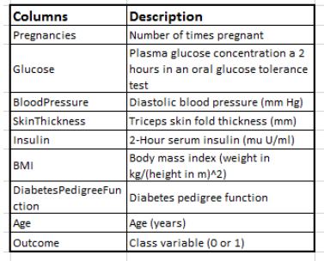
dtypes: float64(2), int64(7)
dtypes: float64(2), int64(7)
Column details:
Train Dataset: 768 observations and 9 variables
dtypes: I. float64 - 2 (BMI, DiabetesPedigreeFunction)
II. Int64 – 7

Slide 4
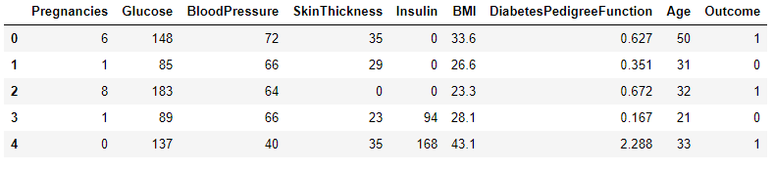
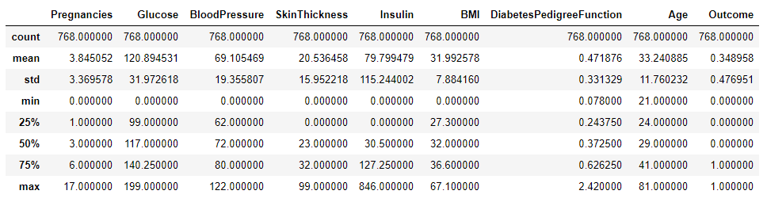
First 5 rows of the data:
Detailed description of data:

Slide 5
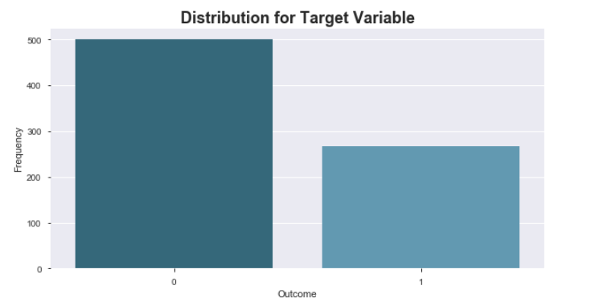
Thus it is clearly visible that the data is unbalanced. There are 268 cells with value as 1 and 500 as 0.

Slide 6
Observations from Pandas Profiling
Dataset info:
Number of variables: 9
Number of observations: 768
Missing cells: 0
Number of zero value cells: 758
Variables types:
Numeric = 8
Boolean = 1
Age has values ranging from 21 to 81 with no missing values and no duplicates. It has mean value as 33.24, the values above 66.5 are outliers (Q3+1.5*IQR) {IQR=Q3-Q1=41-24=17}. and Acceptable.
Blood Pressure has minimum value as 0 and maximum value as 122. It has 35 zero values.
BMI The range of values is 0 to 67.1. with 11 rows with zero values.
Diabetes Pedigree Function has values from 0.078 to 2.42 with no zero values. Acceptable.
Glucose values range from 0 to 199. There are 5 zero value rows. Acceptable.
Insulin has values ranging from 0 t0 846.It also has 374 rows with zero values which accounts for 48.7% of total data.
Pregnancies It has values ranging from 0 to 17 with 111 zero rows.The highest value of 191 is an outlier same is the values ranging above 157.5(Q3+1.5*IQR) {IQR=Q3-Q1=123-100=23}.
Skin Thickness values range from 0 to 99 with 227 zero values.

Slide 7
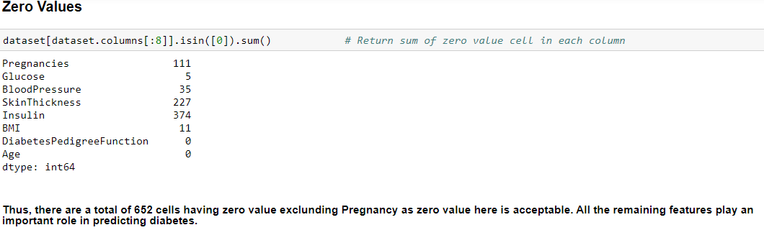
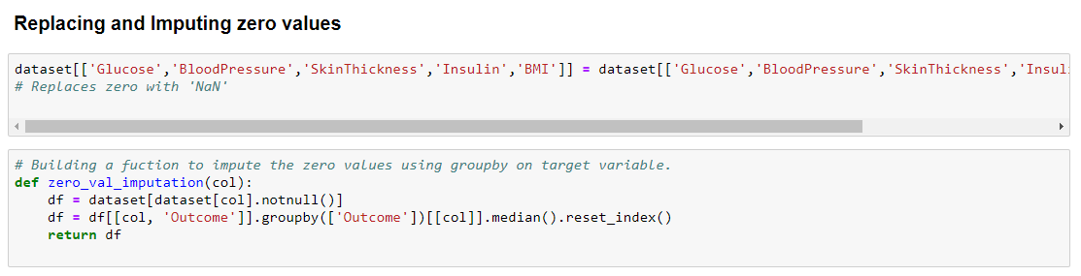

Slide 8
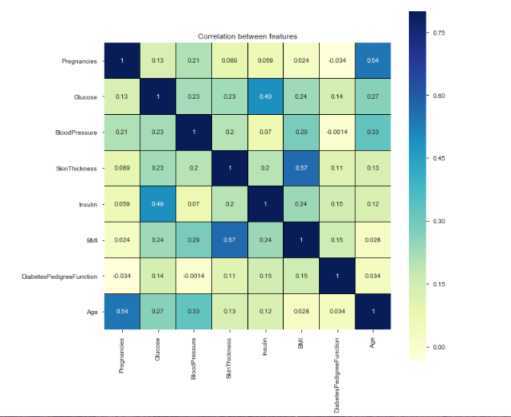
Correlation Matrix:
SkinThickness and Insulin are negatively corelated with Age.
There is no High correlation observed between any features.
BMI is positively correlated with all the features.
With high correlation we face redundancy issues here due to absence of high correlation there aren't any.

Slide 9
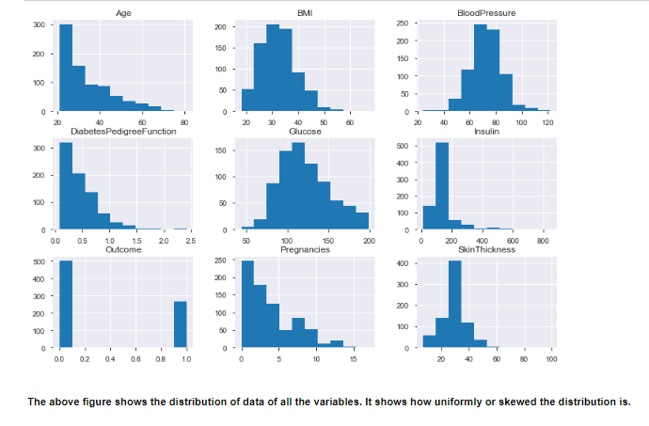
Visualizations:

Slide 10
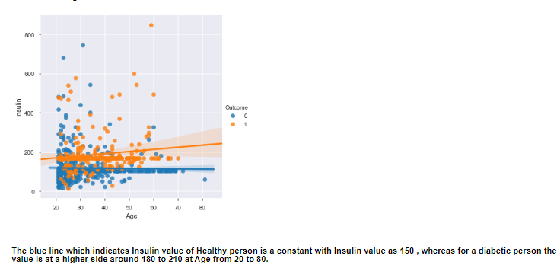
Age Vs Insulin

Slide 11
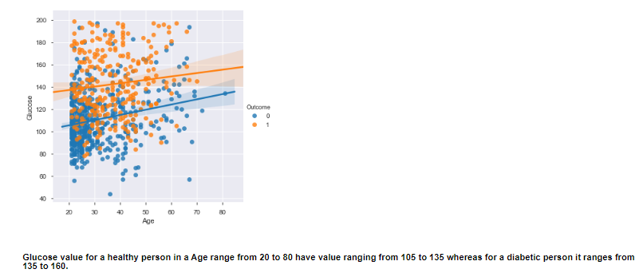
Age Vs Glucose

Slide 12
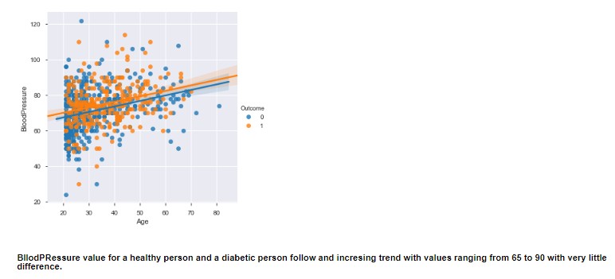
Age Vs Blood Pressure

Slide 13
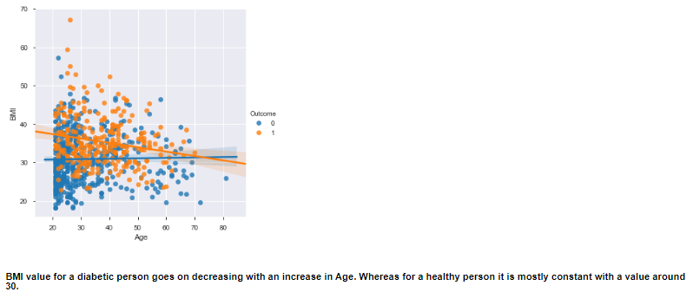
Age Vs BMI

Slide 14
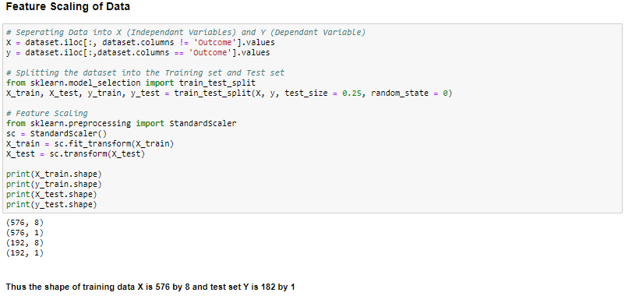
We have divided our dataset into train and test where 75% data is train and rest is test.

Slide 15
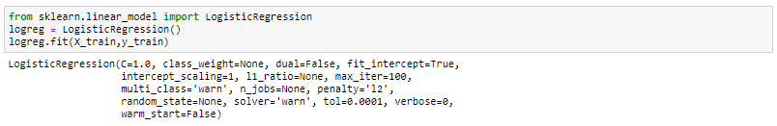
Model Building:
Our Target_Variable is predicting diabetes i.e it’s a binary/categorical dependant variable. Hence we need to build Models based on Classification Algorithm.
Logistic Regression:
It is a Machine Learning classification algorithm that is used to predict the probability of a categorical dependent variable. In logistic regression, the dependent variable is a binary variable that contains data coded as 1 (yes, success, etc.) or 0 (no, failure, etc.). In other words, the logistic regression model predicts P(Y=1) as a function of X.

Slide 16
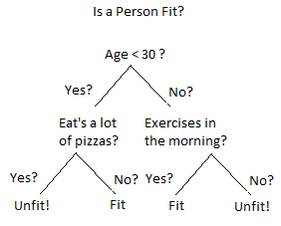
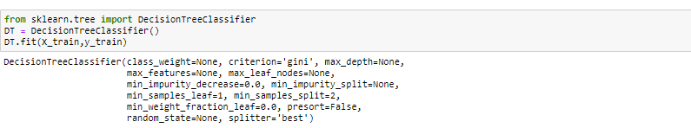
2. Decision Tree Classifier:
A Decision Tree is a simple representation for classifying examples. It is a Supervised Machine Learning where the data
is continuously split according to a certain parameter.
Decision Tree consists of :
Nodes : Test for the value of a certain attribute.
Edges/ Branch : Correspond to the outcome of a test and connect to the next node or leaf.
Leaf nodes : Terminal nodes that predict the outcome (represent class labels or class distribution).

Slide 17
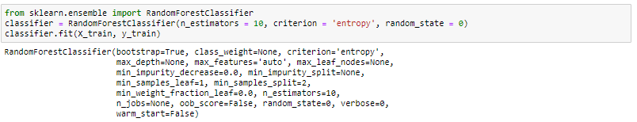
3. Random Forest Classifier: Random forest classifier creates a set of decision trees from randomly selected subset of training set. It then aggregates the votes from different decision trees to decide the final class of the test object.

Slide 18
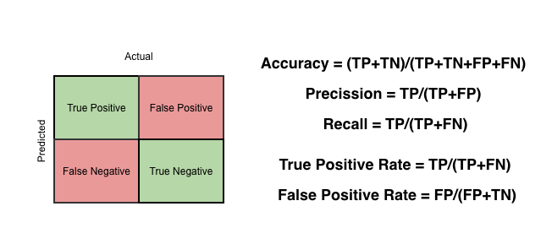
Model Evaluation:
Classification Models are evaluated on the basic on confusion Matrix as below.
Accuracy,Precision,Recall and F1_Score are calculated.
ROC_AUC Curve:
AUC - ROC curve is a performance measurement for classification problem at various thresholds settings. ROC is a probability curve and AUC represents degree or measure of separability. It tells how much model is capable of distinguishing between classes. Higher the AUC, better the model is at predicting 0s as 0s and 1s as 1s. By analogy, Higher the AUC, better the model is at distinguishing between patients with disease and no disease.

Slide 19
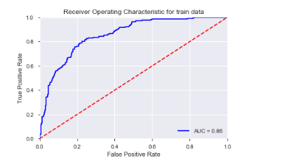
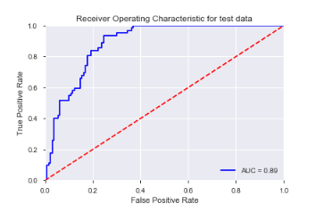
ROC_AUC for Logistic Regression:
The correctly predicted values are 116+34=150 and wrongly predicted are 14+28=42 out of 192.
Accuracy Score = 0.78
Precision Score = 0.70
Recall Score = 0.54
F1 Score = 0.61
AUC = 0.89

Slide 20
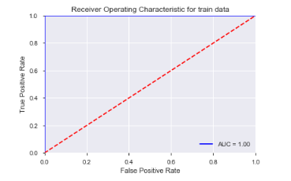
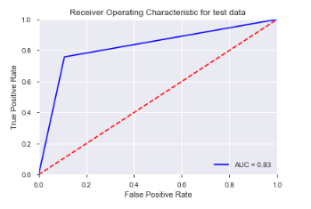
ROC_AUC for Decision Tree Classifier:
The correctly predicted values are 114+49=163 and wrongly predicted are 16+13=29 out of 192.
Accuracy Score = 0.84
Precision Score = 0.75
Recall Score = 0.79
F1 Score = 0.77
AUC = 0.83

Slide 21
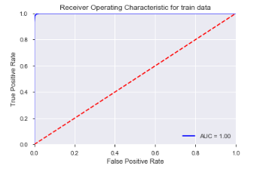
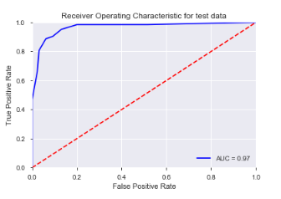
ROC_AUC for Random Forest Classifier:
The correctly predicted values are 122+55=177 and wrongly predicted are 8+7=15 out of 192.
Accuracy Score = 0.92
Precision Score = 0.87
Recall Score = 0.88
F1 Score = 0.88
AUC = 0.97

Slide 22
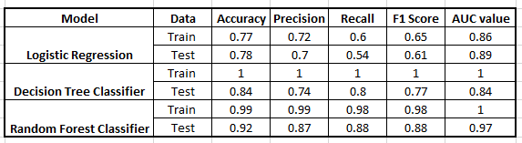
Assembling all the parameter values for above Models:
Model Selection:
The above Models are being used to predict a diabetic person correctly. Hence we should consider the Recall/ Sensitivity value here, as more true positive predictions should be taken into consideration.
Random Forest Classifier gives us the best Recall Score of 0.98.

Slide 23
Also the AUC score i.e the are under the ROC curve value should also be considered in evaluation a successful model. As per General AUC predictions: .90-1 = Excellent .80-.90 = Good .70-.80 = Fair .60-.70 = Poor .50-.60 = Fail Hence the best AUC score which is near to 1 that is a perfect model is Random Forest Classifier with value as 0.97

Slide 24
Conclusion: Thus finally after evaluating all the three Models, We can conclude that Random Forest Classifier works the best on the Pima Dataset.

